Slide 1
Fundamentals of Electric Transmission System Planning Short Course Impact of Distributed Energy Resources on Planning
Scott Dahman
PowerWorld Corporation
scott@powerworld.com
March 19-21, 2024
© copyright Tracy Rolstad, 2024
© copyright Scott Dahman, 2024

Slide 2
Load Records in Power Flow Cases
In system planning tools like PowerWorld Simulator, PSS/E, PSLF, a “load” usually represents a distribution feeder or group of feeders
Distributed Energy Resources (DER) should thus be modeled with the load
Load records in PowerWorld Simulator contain DER fields
User Input
Dist Status: Open or Closed – is the DER in service?
Dist MW: MW output of DER
Dist Mvar: Mvar output of DER
Unit Type: typically PV for rooftop solar, but could also be WT, IC, or any other EIA-recognized prime mover type
Calculated
Net MW: Load MW – Dist MW
Net Mvar: Load Mvar – Dist Mvar
The power flow just “sees” the Net MW and Net Mvar
Transient stability can limit or trip the DER separately from the rest of the load

Slide 3
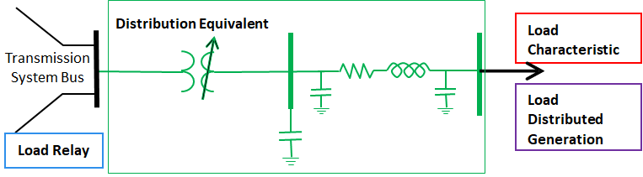
Transient Stability Load Model Relationship

Slide 4
DER Transient Stability Load Models
Supported by PowerWorld Simulator
Specified separately from load characteristic and distribution equivalent (feeder) models
GE PSLF also recently added, but it is lumped in with load characteristic and feeder models
Siemens PTI development is in progress
DGDER_A
Identical to generator machine model DER_A
Essentially a plant, machine, and electrical model with voltage and frequency tripping characteristics
DGPV: current is limited when voltage or frequency are not within a specified range
Use in industry cases (FERC 715)???
If there is no DG stability model -> load characteristic model applies to the net

Slide 5
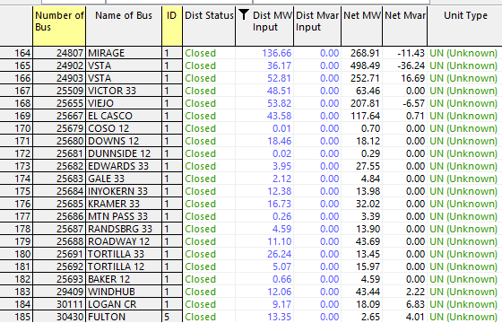
DER Records in WECC 24HSP1a
Included mainly in California and Arizona

Slide 6
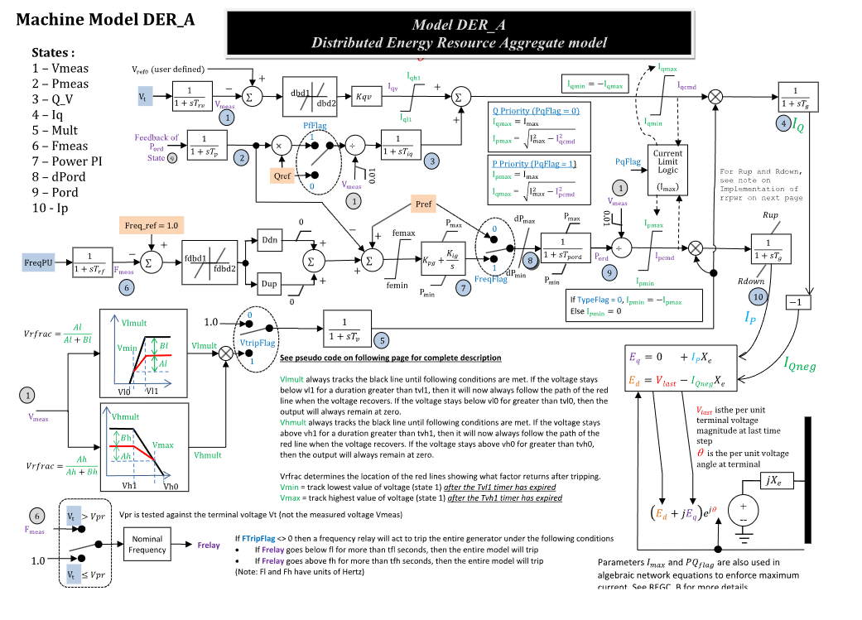
Transient Stability Model: DGDER_A

Slide 7
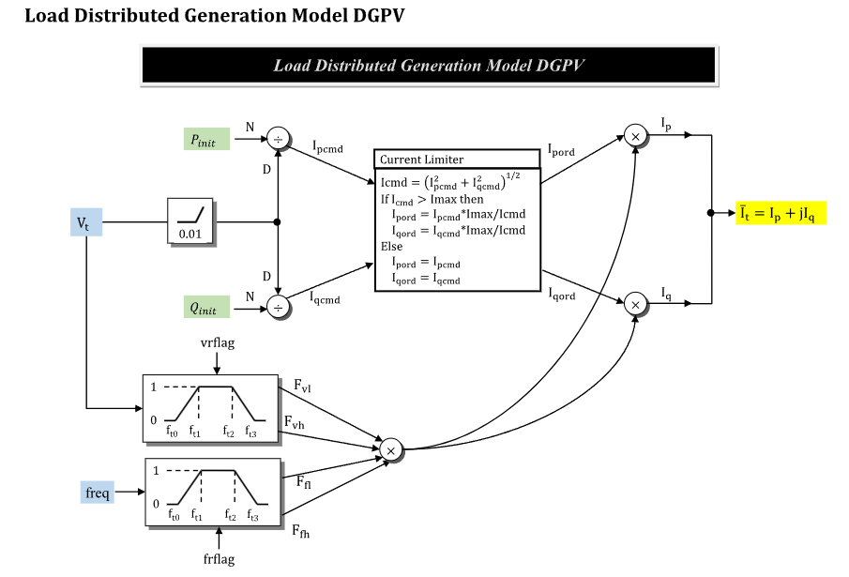
Transient Stability Model: DGPV

Slide 8
Seminar Time
What experiences do you have?
My experience
Never integrate load on a generation feeder
Get them separate
New generation has no behavior experience
Good utility practice says what to do
Not what not to do!

Slide 9
The Fear Writ Large

Slide 10
DER IS Coming
We need a robust system
Distributed Energy Resources
Solar, wind, micro/pico hydro
MUST INCLUDE STORAGE (& inverter behavior)
Batteries
Various kinds are?
Residential thermal storage
Which is what? Thoughts?
Transactive grid is a thing…

Slide 11
Technically Doable
We can do DER but:
It might be expensive
It may forever change the utility model
Rates must accommodate the impact on those unable to buy into DER
The poor may be the only ones left to pay for energy
The rich likely HAVE DER

Slide 12
Modeling Approaches
Do something similar to a FERC SIL study
Decrement your generation off and run ctgs
Guarantee you will go “what the?”
Do the same with load
Decrement your load (i.e. towards zero)
OR increment the DG components of load
Run studies and ponder the results

Slide 13
OATI Graphic (selling software)

Slide 14
Scale is Everything
We can accommodate DER but at what pace and scale is unknown.
California is leading the way…pay attention
Communications and a market are key
The fundamentals are always the same:
Control of voltage and current (i.e. power)
Ramping rates
Who is it for reliability?
PMU’s may become very relevant

Slide 15
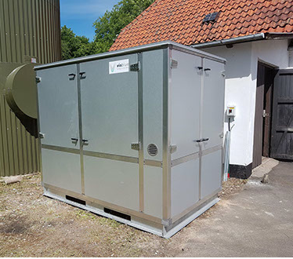

OUTUS is Worth Watching
Australia
VisBlue
Germany
Voltstorage

Slide 16
Vanadium Flow
A vanadium redox flow battery (VRFB) has two separate tanks, one containing a positive electrolyte and one negative electrolyte. Both electrolytes consist of the element vanadium dissolved in sulphuric acid, with the vanadium occurring in different oxidation states (valences).
The battery has a number of battery cells as well. Each of these cells is divided into two chambers separated by a membrane, through which the ions can pass. In each chamber there is a positive or a negative electrode. The two electrolytes are pumped through the cells on their side of the membranes.
The current from the solar panels is fed down into the cells’ electrodes, where it moves electrons from the positive to the negative electrolyte, charging the battery as the liquid flows back into the tank. During discharge, this process is then reversed.
Why is a flow battery desirable over a Li-Ion type?

Slide 17
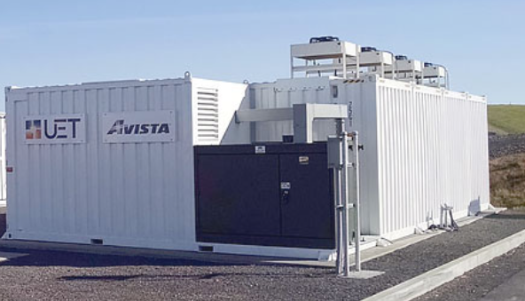
Don’t Be First!
⁺Q
⁻P
⁺P
⁻Q
Any idea where the VC $ is coming from?
4 quadrant control
Economic “stack” of uses

Slide 18
Seminar Time
Pretty sure I am worn out from talking!
Thoughts Please!
Monetizing DER is a HUGE THING for utilities
We think data might part of this…
The vertically integrated utility may be a dinosaur

Slide 19
Questions?

